Slide 1


O'My Darling
Old Chang Kee Catering’s Mobile Food Truck

Slide 2
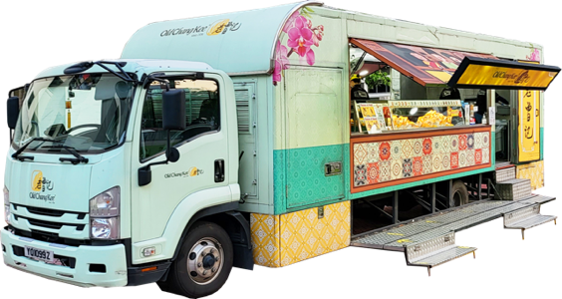
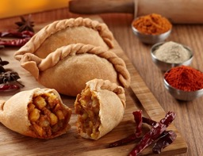
O'My Darling
O’My Darling is a fully-furnished mobile kitchen truck by Old Chang Kee which had achieved and met stringent food hygiene standards stipulated by the relevant government agencies. It is a common sight at high profile events in Singapore such as National Day Parade as official caterer and also as a caterer for PSA, Istana Open house, Polytechnic, RC Events, Corporate Carnival Events, and others.
Choice of food menu can be customized for your event with the booking of our O’My Darling Mobile Food Truck, including our hot-piping Old Chang Kee Snacks, Breakfast & Ready Meals which will be freshly prepared for the event.

Slide 3
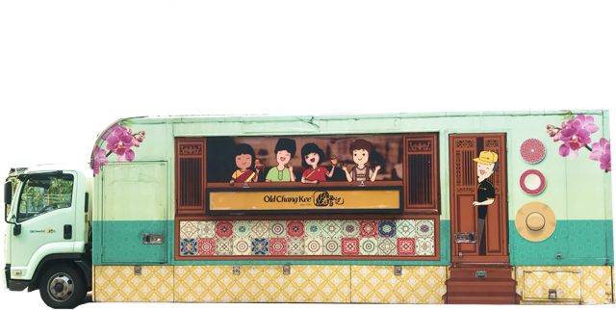

O'My Darling - 1099

Slide 4
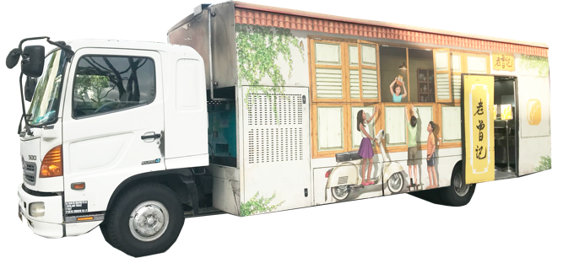
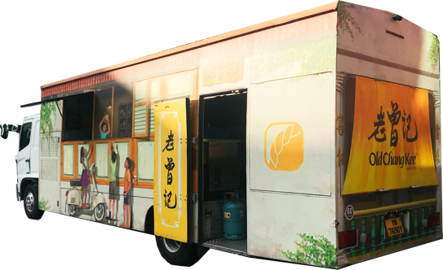
O'My Darling - 7690

Slide 5
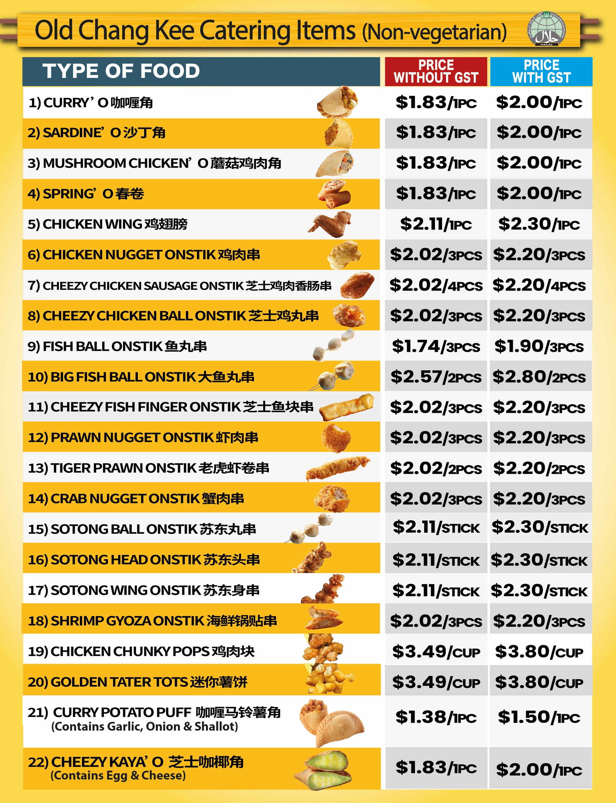
Menu
Old Chang Kee Snack

Slide 6
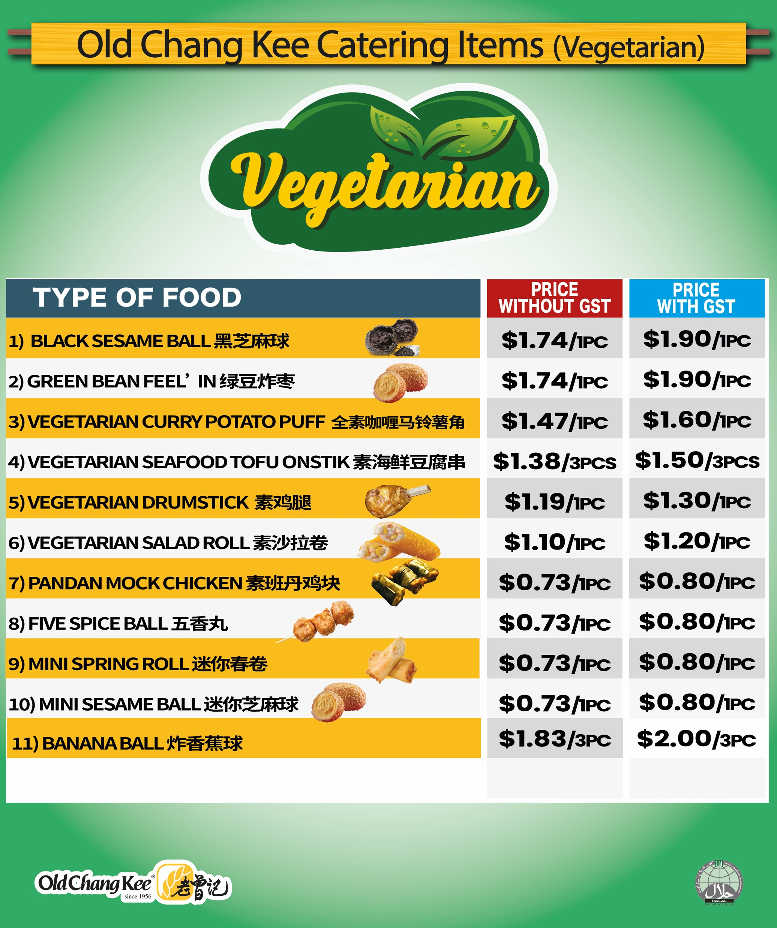
Menu
Vegetarian Snack

Slide 7
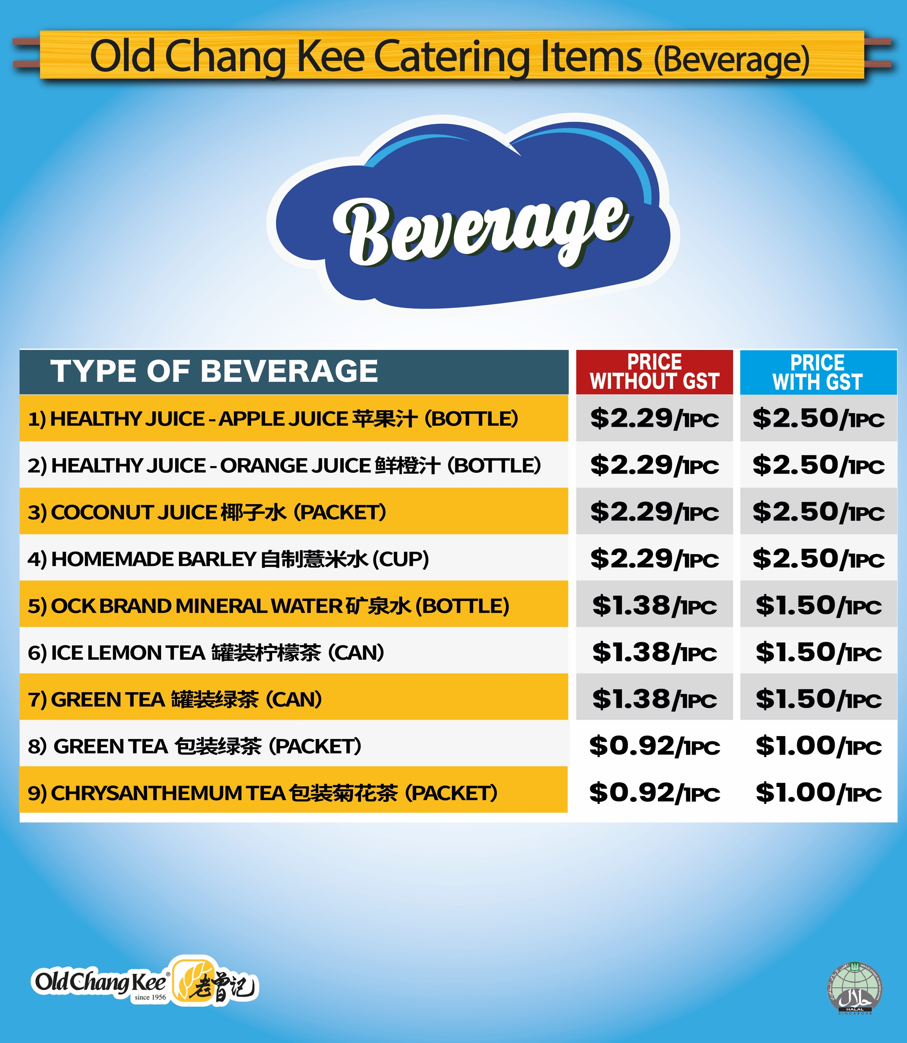
Menu
Beverage

Slide 8
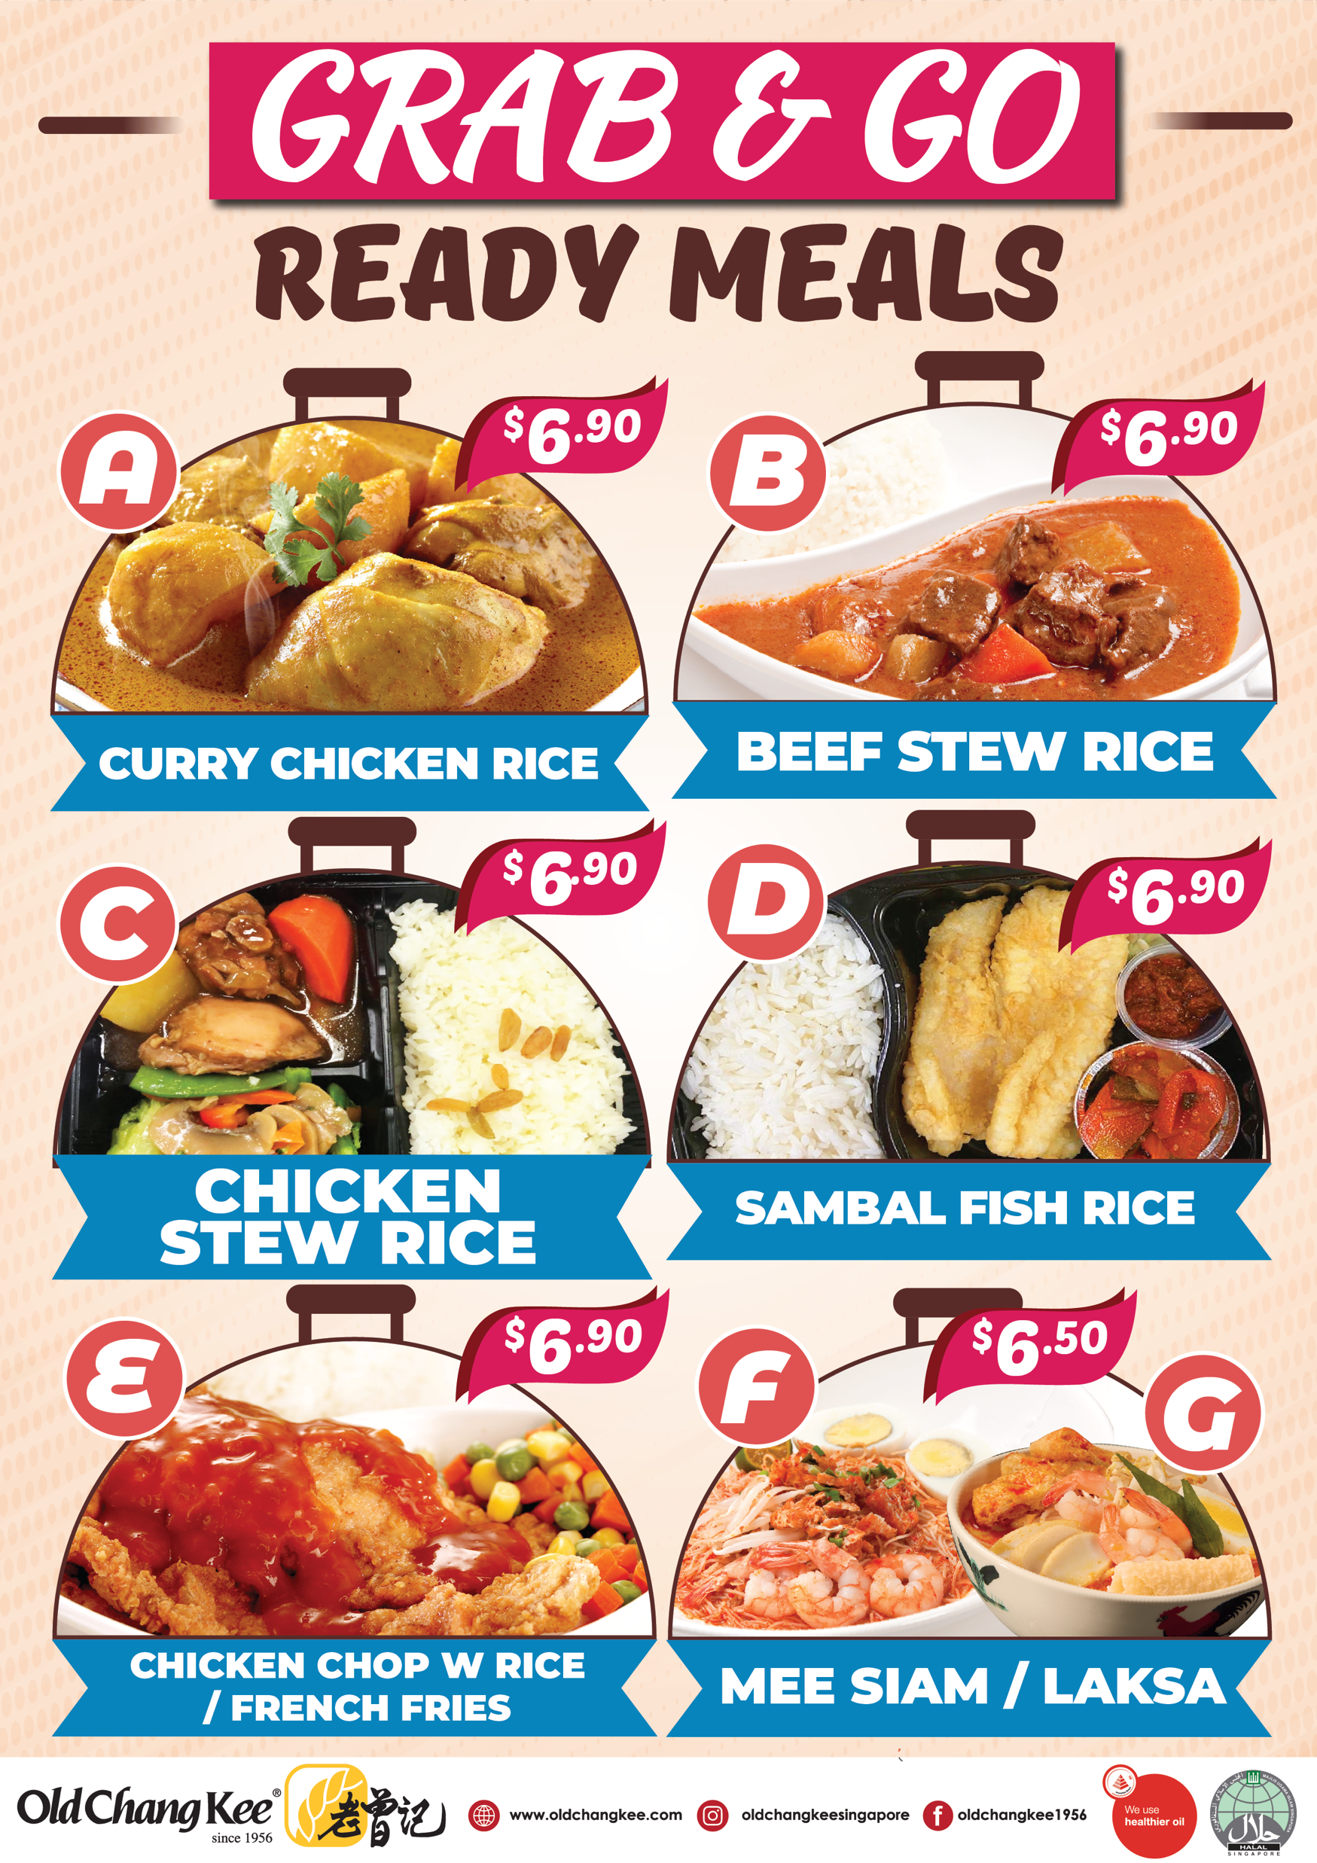
Menu
Ready Meals

Slide 9
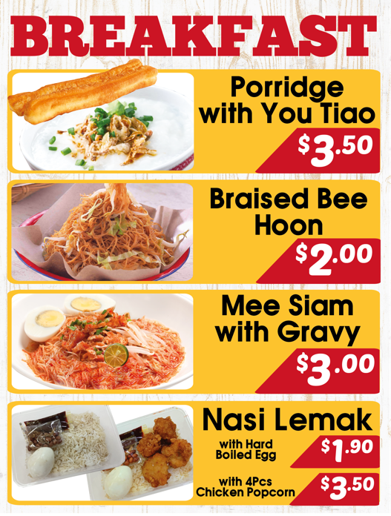
Menu
Breakfast

Slide 10
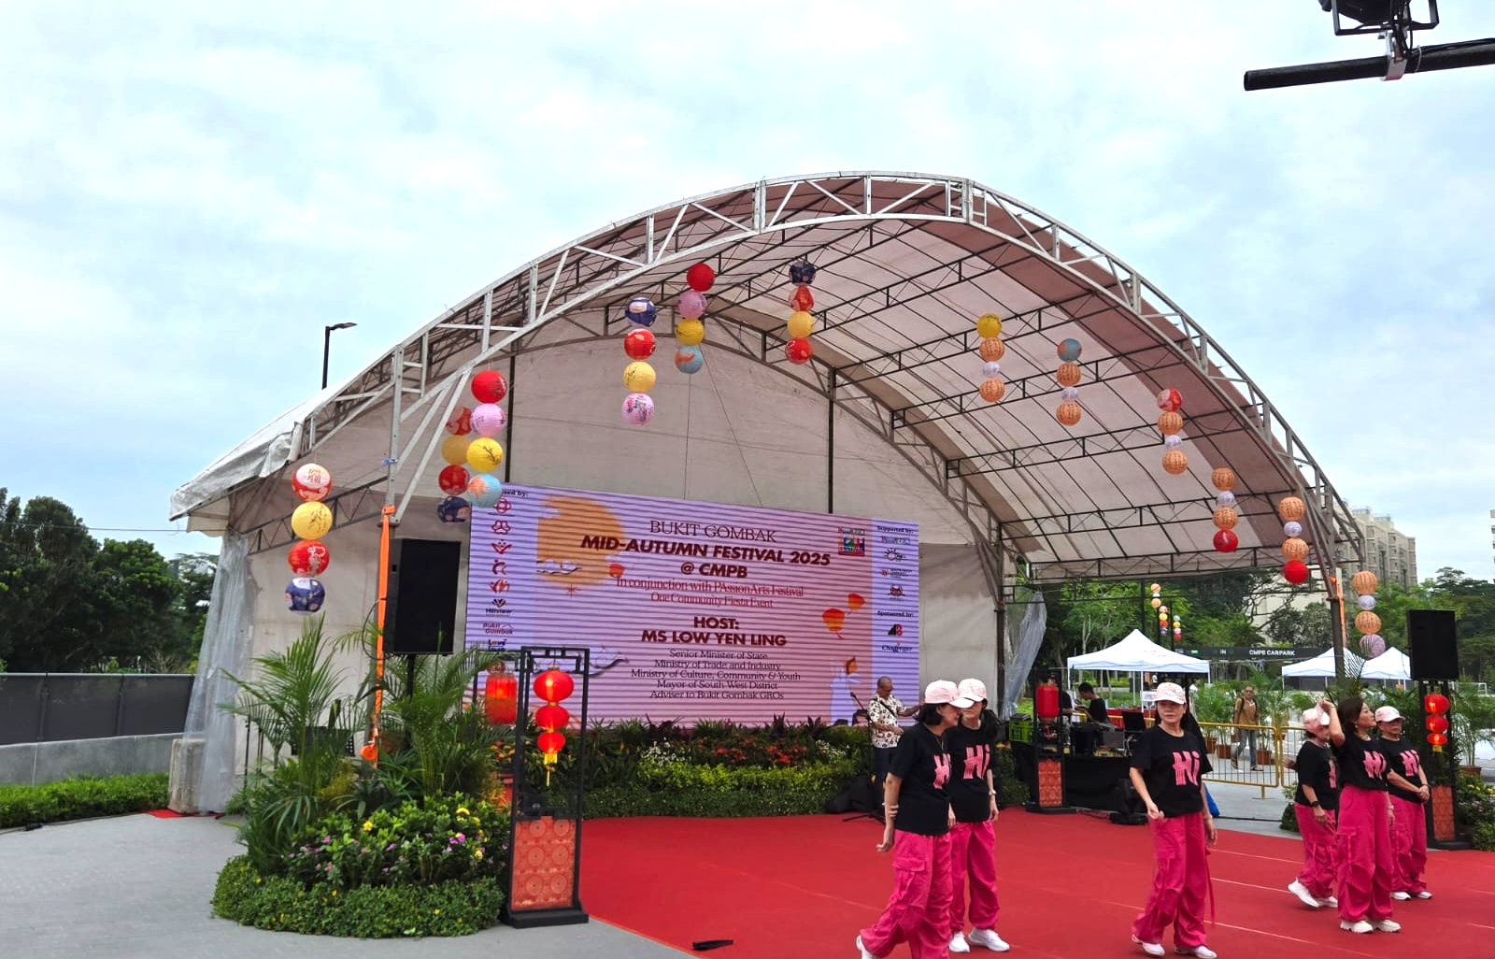
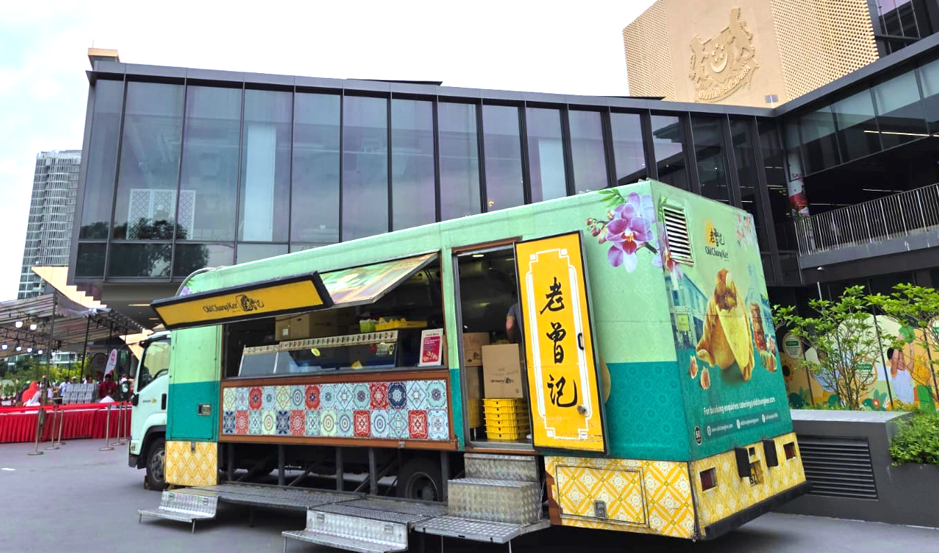

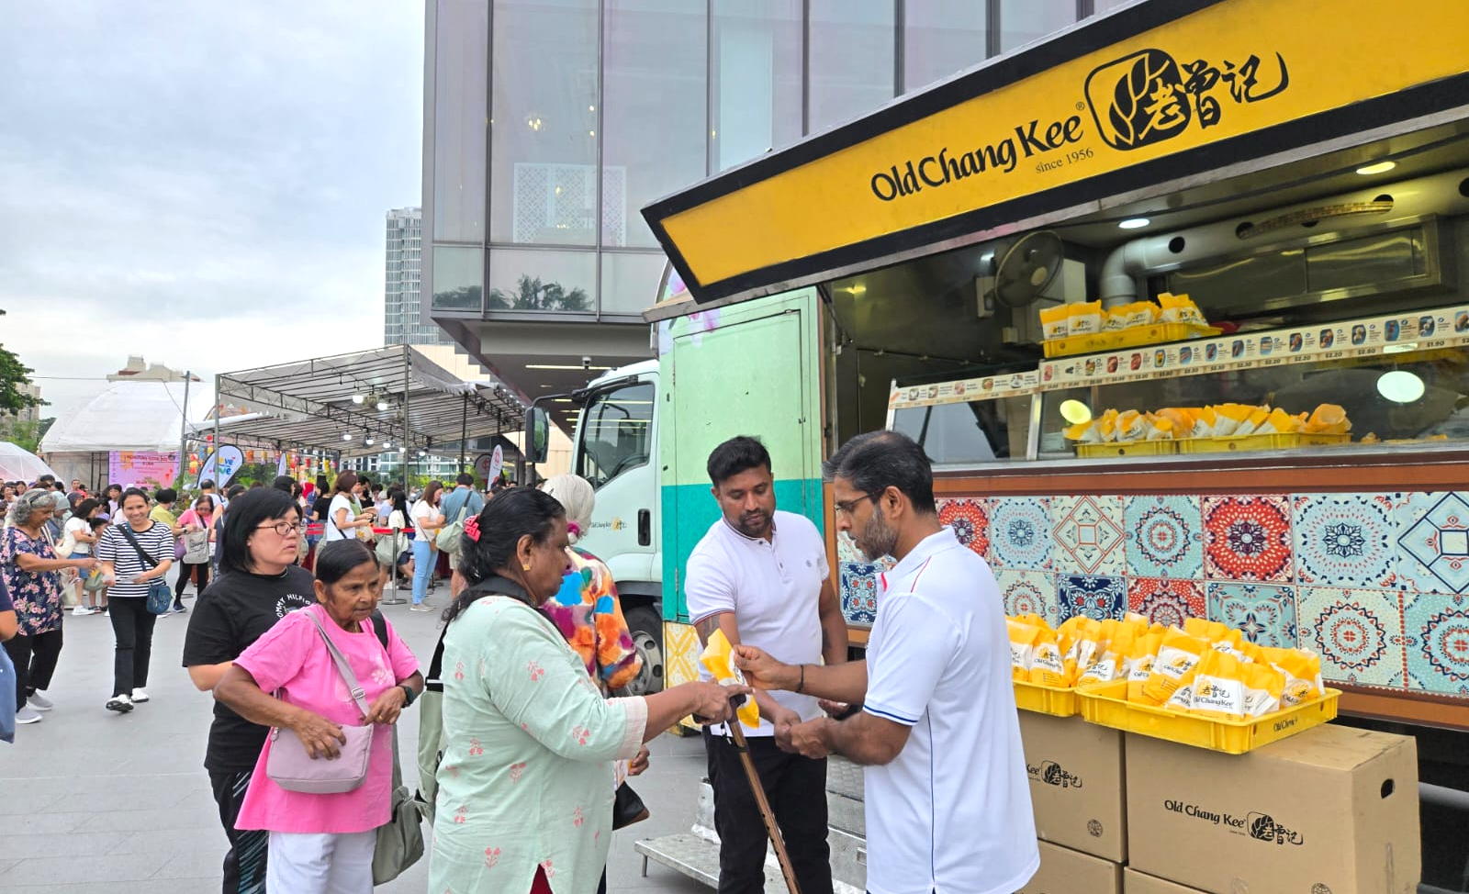
Mid Autumn Festival 2025 Event @ Bukit Batok

Slide 11
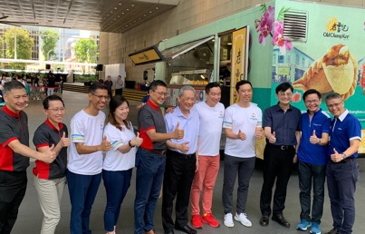
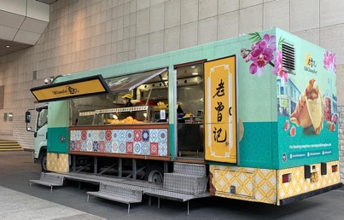
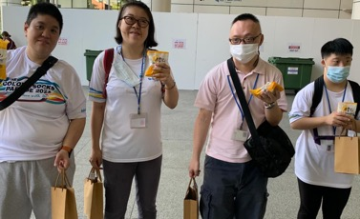
SG Minds Colour Socks Parade 2024 Event @ NLB

Slide 12
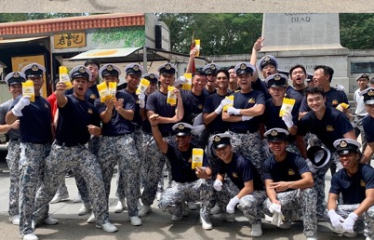
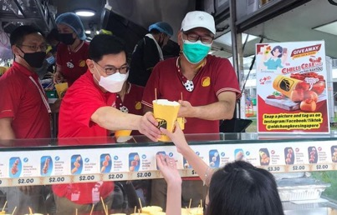
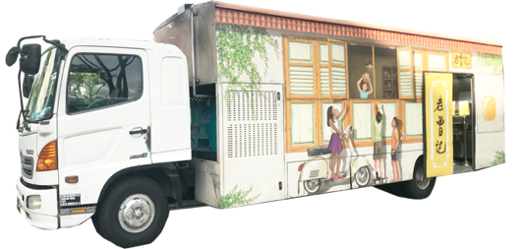
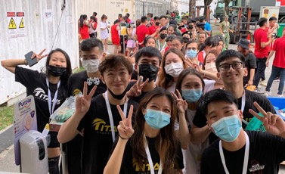
A common sight at high profile events in Singapore.
Partnering with NDP since 2008 - 2025

Slide 13
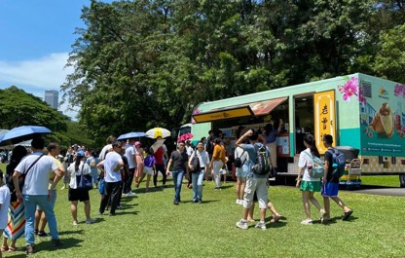
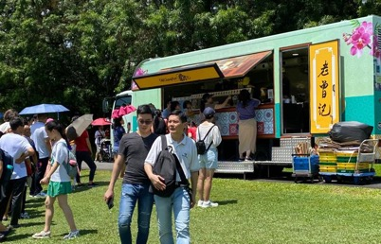
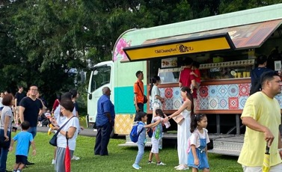
Istana Open House

Slide 14
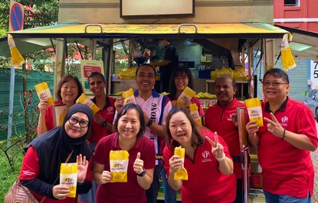
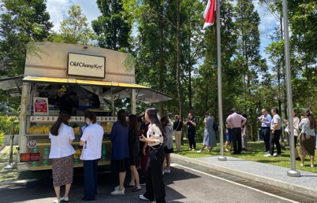
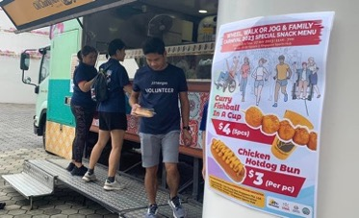
Charity Events e.g. Collaboration with PAs, RCs in food sponsorship

Slide 15
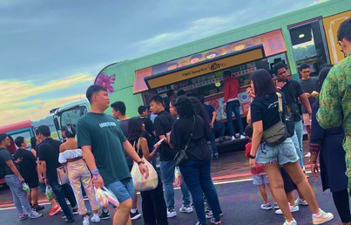
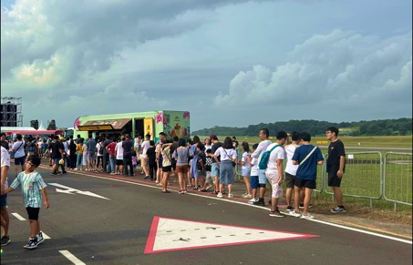
RSAF55 Open House

Slide 16
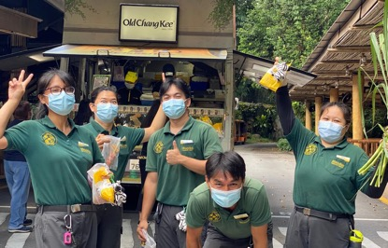
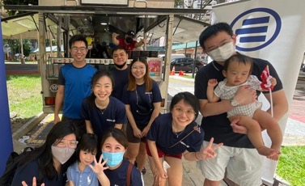
Onsite Corporate Events. Eg. Mandai Singapore Zoo, National Park events & Allianz Insurance etc

Slide 17
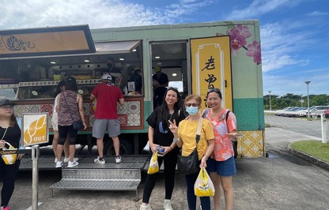
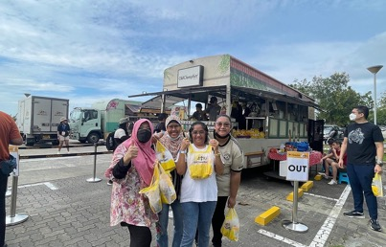
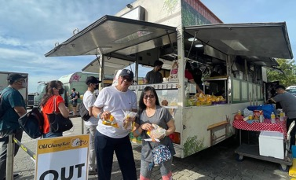
Far East Organization Family Carnival Event

Slide 18
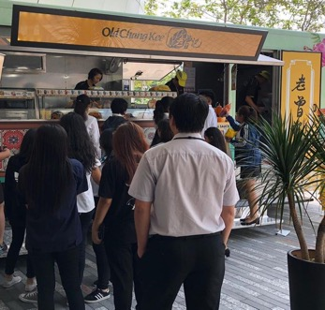
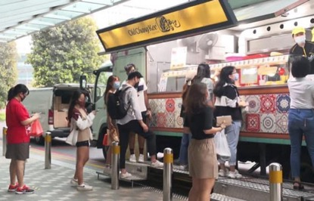
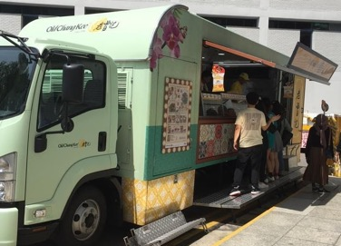
Singapore Polytechnic, SMU & ITE etc

Slide 19
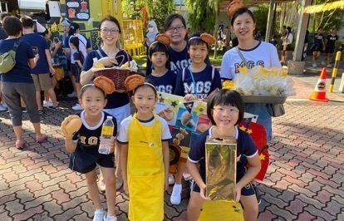
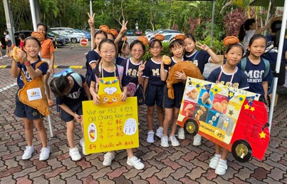
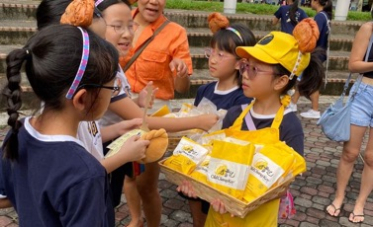
Methodist Girl’s School Carnival Event

Slide 20
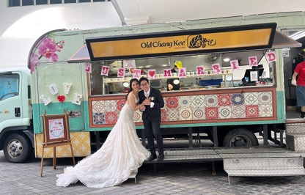
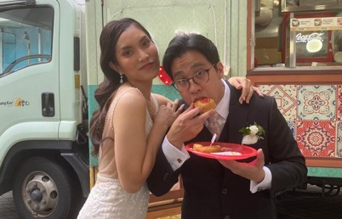
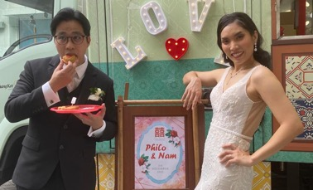
Wedding Event

Slide 21


O'My Darling Specification
Un-laden weight of OMD : 4,620 kg
Max laden weight of OMD : 10,400 kg
Length of OMD : 30 footer
Width of OMD : 4.8 metres
Height of OMD : 3.0 metres
Cylinders in OMD : 2 LPG cylinders (2 x 14 kg)
Clean Water Tank : 200 litre
Waste Water Tank (big basin) : 250 litre
Waste Water Tank (small basin) : 87 litre
Space Requirement: 5 - 6 Parking lots
Self-equipped vehicle
with its own generator, chiller, fryer and
serving station

